Slide 1


ENIAC and MAGIST
COOPERATION?
GROUP 2
Felix
Goodness
Tamuka
Thai Ngoc

Slide 2
Outline
Overview
Is Magist a good fit for high end tech product?
Are orders delivered on time?
Conclusion

Slide 3
OVERVIEW
Time frame: Oct 2016 - Sep 2018
Number of orders: 99441
Number of customers: 99441
Number of products/categories: 32951/74
Number of sellers: 3095
Setting:
High end tech categories: 5 ('electronics', 'computers_accessories', 'computers', 'signaling_and_security', 'tablets_printing_image')
Expensive product: >200

Slide 4
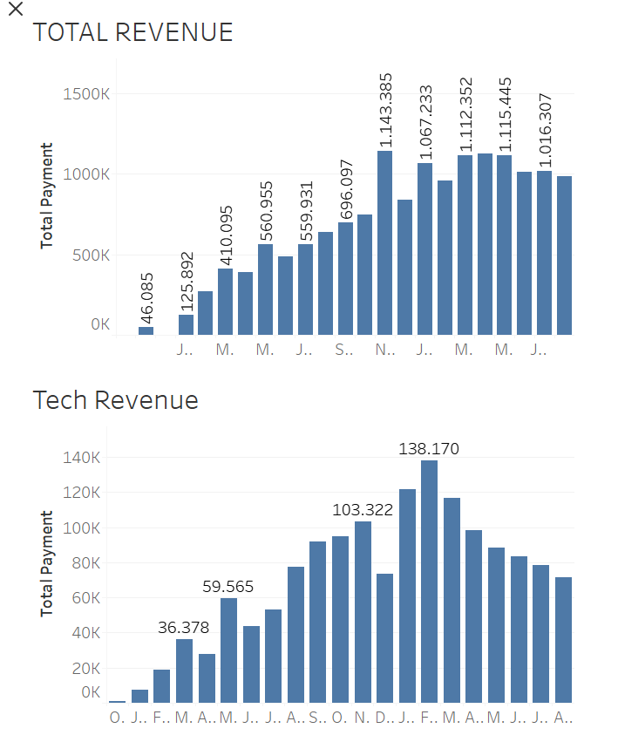
2. Is Magist a good fit for high end tech product?
Total revenue:
15.374.790
Total revenue for high tech products:
1.486.853

Slide 5
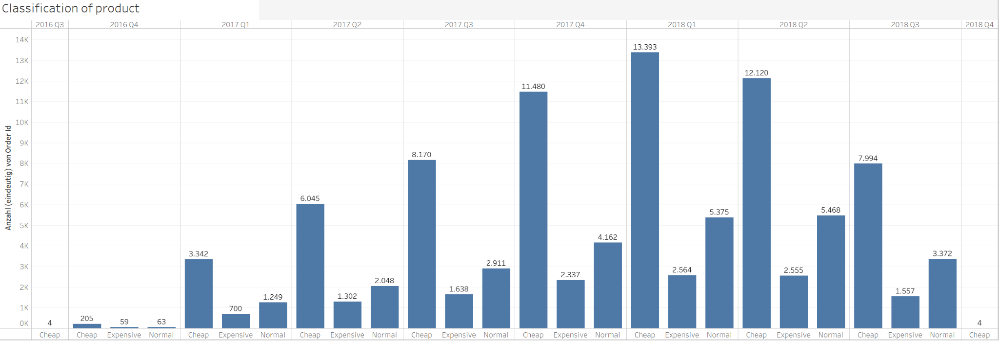
Expensive products
Price range: 5 to 6735

Slide 6
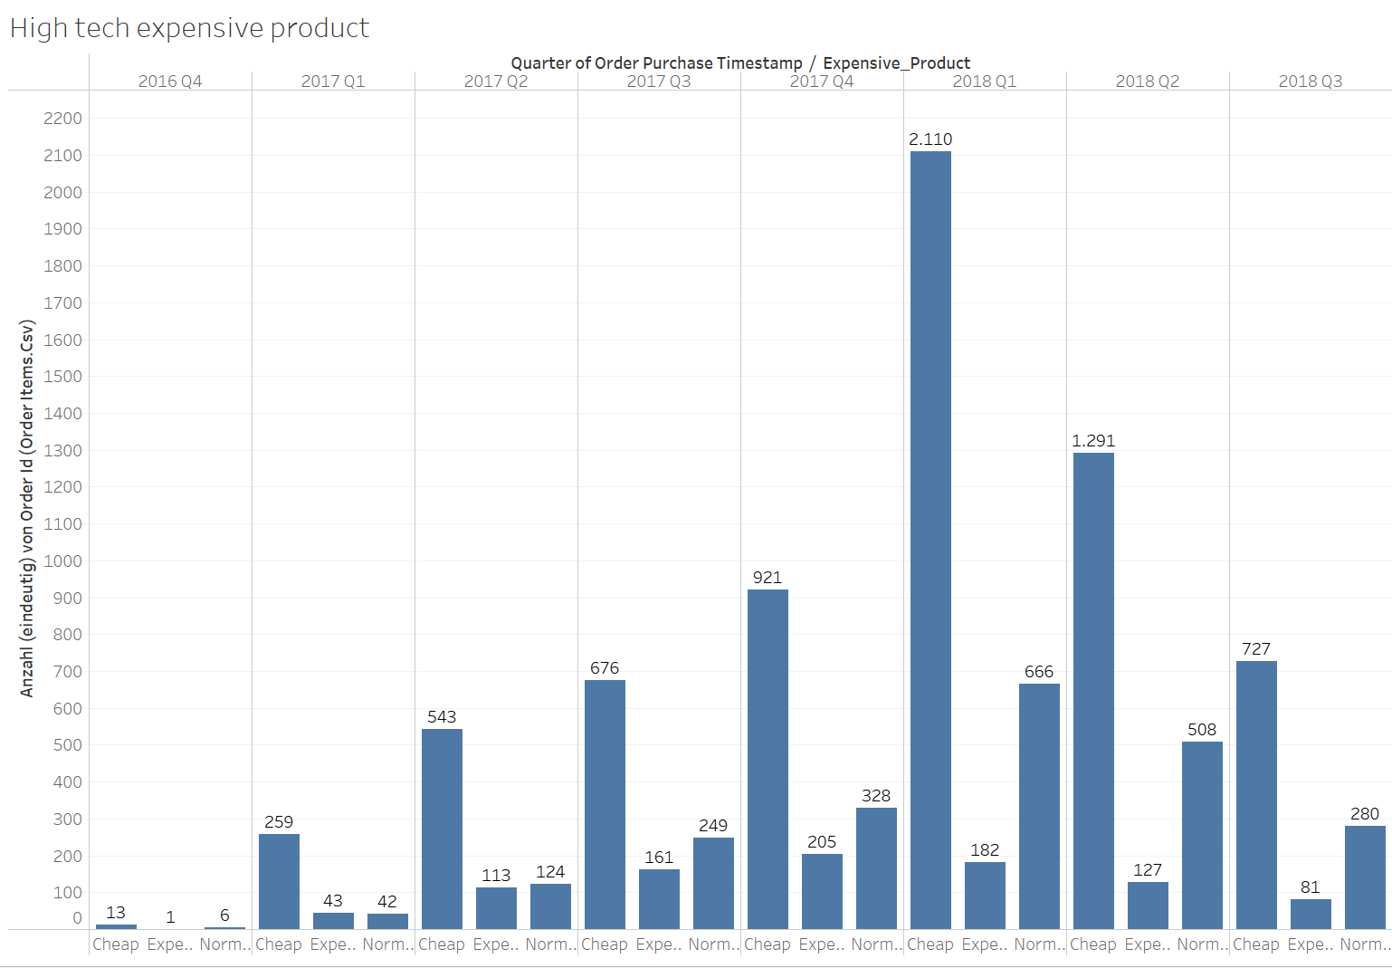
High tech expensive product

Slide 7
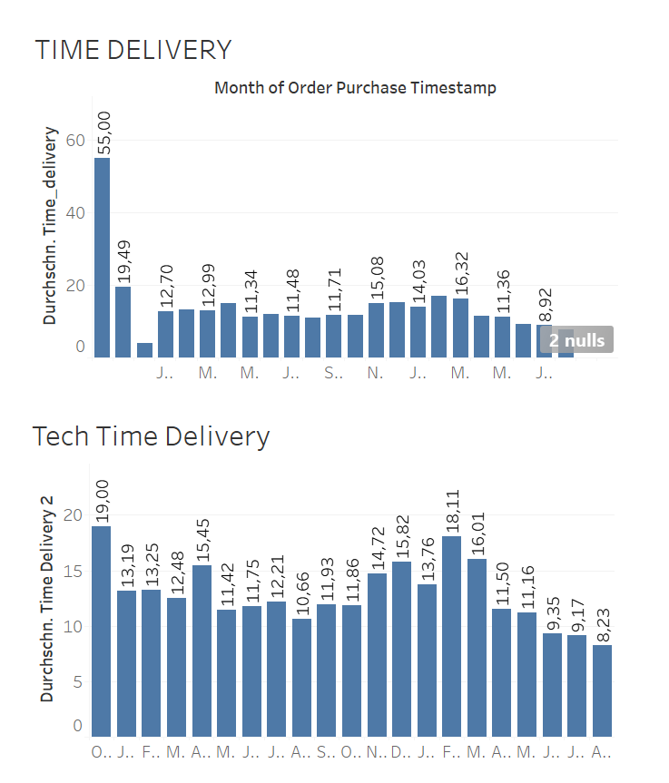
3. Are orders delivered on time?
Average time delivery: 12 days
On time delivery: 88.644 Delay: 7.826 (= ~9%)

Slide 8
4. Conclusion
Revenue declining in the past
Small share of expensive products in sales
Slow deliveries, additionally about 9% deliveries not in time
These framework conditions do not correspond to the demands of customers of premium products that we want to address
Recommendation: No with Magist

